Slide 1
SIGMM Business Meeting November 30, 2011
Klara Nahrstedt (SIGMM Chair)
Rainer Lienhart (SIGMM Vice Chair and Treasurer)
Mohan Kankanhalli (SIGMM Conference Chair)
Detailed SIGMM Report submitted to ACM for 2010-2011 can be found at www.sigmm.org

Slide 2
Current Status and Future Activities
SIGMM Awards
SIGMM Venues – Interesting Events
SIGMM Special Projects
SIGMM Membership and Budget
Future SIGMM Efforts

Slide 3
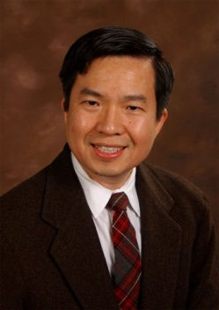
SIGMM Awards – Technical Achievement Award
2011 Winner Prof. Shih-Fu Chang
Columbia University, USA
Talk: November 29,
Pioneering contributions to content-based multimedia analysis and retrieval
New Award Nominations due: May 1, 2012
Submission Process:
Follow Information at
http://www.sigmm.org/Awards/award_taa

Slide 4
SIGMM Awards – Outstanding PhD Thesis
Submission Deadline: March 31, 2012
Awards Committee: Svetha Venkatesh(chair), Dick Bulterman, Abed El Saddik
Nomination Condition: Must have deposited PhD thesis between January 2011 and December 2011.
Submission Process: Via website
For more information see
http://www.sigmm.org/Awards/thesisaward

Slide 5
SIGMM-sponsored Venues
ACM Multimedia 2010 (Florence)
Record attendance
ACM Open Source Software Competition
Multimedia Grand Challenge
Highly successful digital art exhibition
Very interesting keynotes – Shah@Florida and Watts@Yahoo!
ACM ICMR 2011:
First time held in April, 2011, Trento, Italy
Merger of CIVR and MIR conferences
Practitioner Day !!

Slide 6
SIGMM-Sponsored Venues
ACM MMSys 2011:
Organized in Cisco facilities, high attendance of the event especially from the industry
Very interesting keynotes – Fiocco@Cisco and Watson@Netflix
Innovative dataset track – presenting various traces to the community (VR-based network traces, corpus of datasets interesting to multimedia system researchers)
ACM MM&Sec 2010 and NOSSDAV 11:
SIGMM-sponsored workshops with leading edge of multimedia topics (biometrics in travel documents, privacy-preserving approaches in multimedia data, impact of quality experience on multimedia systems)

Slide 7
2012 SIGMM Conference Venues
Major future SIGMM Sponsored/Co-Sponsored Conferences
ACM SIGMM-sponsored Multimedia 2012 – Japan (Nara)
ACM SIGMM-sponsored NOSSDAV 2012 – Canada (Toronto)
ACM SIGMM-sponsored MMSys 2012 – USA (North Caroline)
ACM SIGMM-sponsored ICMR 2012 – USA (Dallas)
Many Conferences have SIGMM In-Cooperation Status

Slide 8
SIGMM Conference Venues
Bids for ACM Multimedia 2014 (in North America)
Bid Decision Process
SIGMM Executive Committee will vote (except EC members who have conflict of interest, i.e., are parts of the bidding teams)
Nahrstedt, Lienhart, Kankanhalli, Rainer Lienhart (SIGMM Officers)
Jain (Former SIGMM Chair)
Steinmetz, Plagemann, Griwotz, (EiC of Publishing Venues)
Prabhakaran/Candan/Panchanathan (current MM’11 chairs)
Aizawa, Babaguchi, Smith (future MM’12 chairs)

Slide 9
Special Event - Networking of Multimedia Women
Goal: Increase participation of women in our community
1st event - lunch at ACM MM’10
2nd event – session at ACM MM’11
November 30, 2011 with a Theme: “ Go Beyond Epsilon Science”
Starting 2012 - New SIGMM Initiative – Participation in ACM-W Scholarship program !!!
Female PhD will receive scholarship from ACM-W to attend ACM Multimedia conference in the future.
SIGMM will pay for registration as well as provide conference mentor.
ACM-W Chair: Valerie Barr
http://women.acm.org/participate/scholarship/index.cfm

Slide 10
ACM free linking service - Author-Izer
ACM Author-Izer - unique service that enables ACM authors to post links on either their own web page or institutional repository for visitors to download the definitive version of their articles from the ACM Digital Library at no charge !!!
ACM Author-Izer allows dynamic display of download and citation statistics for each “authorized” article on the author’s personal page.
By linking author’s personal bibliography with the ACM Digital Library, downloads from the author’s site are captured in official ACM statistics, more accurately reflecting total usage.
ACM Author-Izer expands ACM’s reputation as an innovative “Green Path” publisher.”

Slide 11
ACM Author-Izer
Free service for both authors and visitors to authors’ websites
Service can be applied to all articles you have published with ACM
With widespread usage of this service – need to post your author-prepared versions should be alleviated
Automatic indexers will point to article in DL rather than alternative versions hosted elsewhere without promise of being permanently maintained
http://www.acm.org/publications/acm-author-izer-service

Slide 12
SIGMM Membership and Finances
Currently 400 SIGMM Members (decrease from last year 416)
Sound budget
Join SIGMM for: $20 professional (per year) and $15 students (per year)
Receiving SIGMM Records, email-list for SIGMM members only
Access to some SIGMM web site information for SIGMM members only (edu material, …..)
Discount for student registrations in some of the future ACM SIGMM sponsored conferences
Join SIGMM – really important for the health of the community !!!

Slide 13
What Does SIGMM Fund?
SIGMM Fees for ACM (each SIG does)
Funding of SIGMM awards (Technical Achievement Award and Outstanding PhD Thesis Award)
Funding of TOMCCAP awards (Best Associate Editor Award Plaque, Future Nicolas Georganas Best Paper Award )
Travel Grants for Students to ACM Multimedia
Partial expenses for TPC meeting of ACM Multimedia conference
Funding of SIGMM-specific professional meetings

Slide 14
Future Steps
Prepare celebration of 20 Years of ACM Multimedia at MM’12
Increase student travel support through all SIGMM-sponsored venues (as finances allow)
Increase women participation in SIGMM (bottom up – participation of more female researchers in organization of ACM SIGMM-sponsored conferences program committees, area chairs, ….)
Increase industry participation – practitioners’ day
Automate preservation process of talks, web, …
Looking for new initiatives – new competitions at SIGMM-sponsored venues
Email to klara@illinois.edu

Slide 15
Next Talks
Ralf Steinmetz – State of ACM Transactions on Multimedia Computing, Communications and Applications Journal
Balakrishnan Prabhakaran – State of SIGMM Web Magazine and Portal
Carsten Griwotz – State of SIGMM Records Newsletter
Thomas Plagemann – State of Springer Multimedia Systems Journal
Wei Tsang Ooi – SIGMM Educational Efforts
Mohan Kankanhalli – Discussion of Future conferences
Bids for ACM Multimedia 2014 in North America

Slide 16
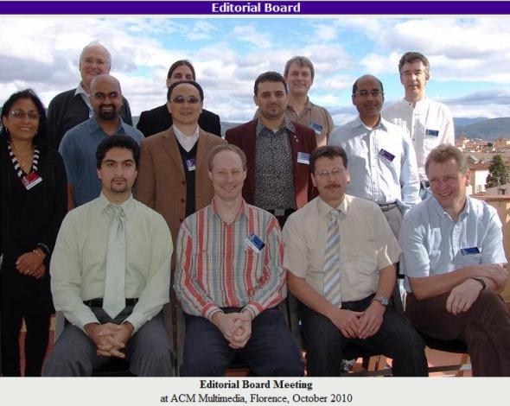
ACM Business Meeting Nov 30th 2011
ACM Transactions on Multimedia Computing, Communications and Applications (TOMCCAP) Status Report
Ralf Steinmetz
Editor-in-Chief of TOMCCAP
ACM Multimedia 2011- Scottsdale, Arizona

Slide 17
TOMCCAP Overview
History
Formed in Jan. 2004
First Issue Feb. 2005
Today
published quarterly
in color
~8 papers per issue
since 2008
Available at ACM Digital Library
tomccap.acm.org
One Special Issue per year (November Issue):
2007: Eye Tracking in Multimedia Applications
2008: Interactive Television
2009: Knowledge Media
2010: Multimedia Sensor Fusion
2011: Social Media
2012: 3D Mobile Multimedia
Since 2011
one additional online-only issue with special section on
extended version of ACM MM best papers

Slide 18
TOMCCAP 2011 News (1)
TOMCCAP ranked 3rd time by ISI Journal Citation Report
June 2011
current ranking (2011): impact factor 1.40
rank 2 in multimedia
2010:
impact factor 1.170 (rank 3)
2009 (debut ranking):
impact factor 2.465 (rank 1)
highest ranked "multimedia" journal
Page limit takes effect
to 20 pages (plus) +5 pages online appendix
Submissions
slight decrease in regular submissions ~9 % less than 2010
accept 24, reject 59, total 83
acceptance ratio 29%
Page budget for “2012”
2012 = July 2011- June 2012
750 pages
Early online publication
started with vol. 7 issue 1, Feb 2011
reduction of publication delay
on paper acceptance → publication around 1 year
issues appear online around two month before shipping

Slide 19
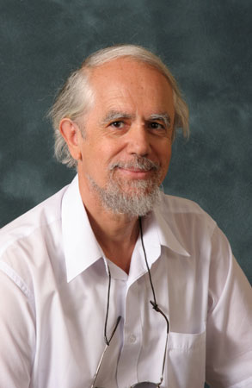
TOMCCAP 2011 News (2)
Named Award: "Nicolas Georganas“
Accepted for
best original TOMCCAP paper
first time awarded
For best TOMCCAP paper 2011
at ACM MM 2012
Volume ~ Feb. 2012:
Additional Set of Related Papers
on P2P-Streaming
online-only
in order to decrease publication delay

Slide 20
TOMCCAP Editorial Board
Yong Rui, Microsoft Research
Shervin Shirmohammadi, University of Ottawa
Hari Sundaram, Arizona State University, US
Svetha Venkatesh, Curtin University of Technology, Australia
CHANGSHENG XU, Chinese Academy of Science, Beijing
Michelle X. Zhou, IBM T.J. Watson/IBM China Research Lab
Roger Zimmermann, National University of Singapore
Left the board:
SAVITHA SRINIVASAN; IBM
KARRIE KARAHALIOS, University of Illinois at Urbana – Champaign, US
Information Director
SEBASTIAN SCHMIDT, Technische Universität Darmstadt, Germany
Lasse Lehmann, AGT Germany
Editor-in-Chief :
Ralf Steinmetz Technische Universität Darmstadt, Germany
Editorial Board:
Kiyoharu Aizawa, University of Tokyo, Japan
GRENVILLE ARMITAGE, Swinburne University of Technology, Melbourne, Australia
Susanne Boll, University of Oldenburg, Germany
Wolfgang Effelsberg, Univ. of Mannheim; Germany
Abdulmotaleb El Saddik, University of Ottawa, Canada
GERALD FRIEDLAND, University of California
Carsten Griwodz, University of Oslo, Norway
MOHAMED HEFEEDA, Simon Fraser University
Mohan S. Kankanhalli, National University of Singapore
Rainer Lienhart, University of Augsburg, Germany
Ketan Mayer-Patel, University of North Carolina at Chapel Hill, US
Klara Nahrstedt, University of Illinois at Urbana – Champaign, US
Thomas Plagemann, University of Oslo, Norway
CAPITAL LETTERS indicates changes since last report

Slide 21
ACM Staff (related to TOMCCAP)
Headquarters Staff
LAURA LANDER
Publisher
Associate Director of Publications
Irma Strolia
Editorial Assistant
Joanne A. Pello
Media Content Marketing
Production
CAPITAL LETTERS indicates changes since last report

Slide 22
TOMCCAP Statistics
 | 2011 (Oct.12) | 2010 (Oct.12) | 2009 (Sep.19) | 2008 (Sep. 4)
Accept | 24 | 20 | 17 | 14
Reject | 59 | 47 | 29 | 31
Total | 83 | 67 | 46 | 45
Accept Ratio | 29% | 30% | 37% | 31%
Time to first Decision | 71 days | 68 days | 87 days | 94 days
TOMCCAP Stats as of October 12th, 2011 (YTD)
Note: The statistics do not include
special issues and special sections
many rejections due to formal reasons, due to clear “out of scope” like long papers, wrong layout template, …

Slide 23
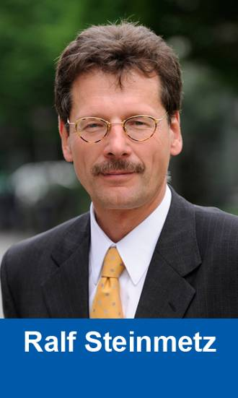
TOMCCAP Outlook
→ TOMCCAP needs you …
submit your excellent research papers to ACM TOMCCAP !

Slide 24
@Klara: this is a reminder that are having a SIGMM Business Meeting on Wednesday, November 30, 4:30-6:30pm in the Arizona Ballroom IV/V.
I assume that all of you will attend the business meeting and present the various activities that you have been engaged in to inform SIGMM and the general ACM Multimedia community about the various activities, status as well as future steps and announcements. I think a lot of things are happening, our community is very vibriant and so it should be a great meeting to present the status as well as look into the future of this exciting field.
Since we have only two hours, here is some guidance on the timing. Please, let me know if you need more time or are not coming. If you are not coming, it would be good if I could get the slides from you and present it as part of the overall SIGMM overview. So here is the agenda (Please, take the upper bounds as maximum times):
Action Items:
(a) please, email all your slides to me and Prabha for two reasons: (1) I am hoping that we can avoid switching times by having all the presentations on one laptop - I have PC (not MAC yet) and speed up the process.) (2) It would be good to post all the reports on the SIGMM website after the ACM Multimedia 2011 so that SIGMM community can see what is going on. I think it is important to have transparency and we want to advertise our achievements and activities.
(b) Please, keep the news/state of your venues to the most important issues. You can put more on the slides, but don't have to present all, just the most important issues.
1. Overall State of the SIGMM Union (Klara -max 20 minutes)
2. State of the SIGMM Web Portal (Prabha - max 10 minutes)
3. State of the ACM Transactions on Multimedia Computing, Communications and Applications (Ralf - max 10 minutes)
4. State of SIGMM Records (Carsten - Max 10 minutes)
5. State of Springer MMSJ (Thomas - Max 10 minutes)
6. Educational Initiative (Wei - max 10 Minutes)
7. SIGMM Preservation Initiative (Mohamed - max 5 minutes)
8. Technical Achievement Awards Committee (Rainer - max 5 minutes)
9: Other News on Initiatives (Hari - max 5 minutes)
(other news ..... 5-10 minutes buffer - not sure if MTAP EiC will want to introduce himself, etc. - did not get any information about it. )
10. State of Conference(s) and Bids for ACM Multimedia 2014 (Mohan - max 30 minutes)

Slide 25
SIGMM.org Report
B. Prabhakaran
Editor-in-Chief of SIGMM.org Web Portal

Slide 26
SIGMM.org
Key Tasks Done
PhD Dissertation Award web site updates
User Interface Updates
Moving data from UT Dallas server to ACM Server

Slide 27
ACM SIGMM Website (2010-2011)
Modifying the PhD thesis uploading site
for 2011 SIGMM Award for Outstanding PhD Thesis
( http://sigmm.utdallas.edu:8080/drupal )
Added menu for sending emails requesting three endorsement letters supporting the nomination

Slide 28
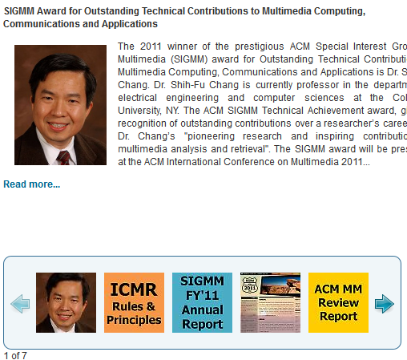
ACM SIGMM Website (2010-2011)
Changing SIGMM website
Moved old data into new ACM server (e.g. history archives, records, etc.)
New news sliders in main page

Slide 29
SIGMM.org
Tasks Underway
Modifications for PhD Dissertation Award web site based on feedback from the committee
Mobile phone access
Multimedia Journals Info Page
Open Source Software
Social Media

Slide 30
Multimedia Journals Info
Create Infrastructure for Periodic Updates from
ACM TOMCCAP
Multimedia Systems Journal (Springer)
Multimedia Tools & Applications (Springer)
Journal of Multimedia (Academy)
International Journal of Multimedia Data Engineering and Management (IGI Global)
Advances in Multimedia (Hindawi)
International Journal of Multimedia Information Retrieval (Springer)

Slide 31
New Editors
Open Source Software
Pablo Cesar & his team
Social Media
K. Selcuk Candan, Marcel Worring & Their Team

Slide 32
SIGMM: Open Source Multimedia Software
Pablo Cesar, CWI, the Netherlands
p.s.cesar@cwi.nl

Slide 33
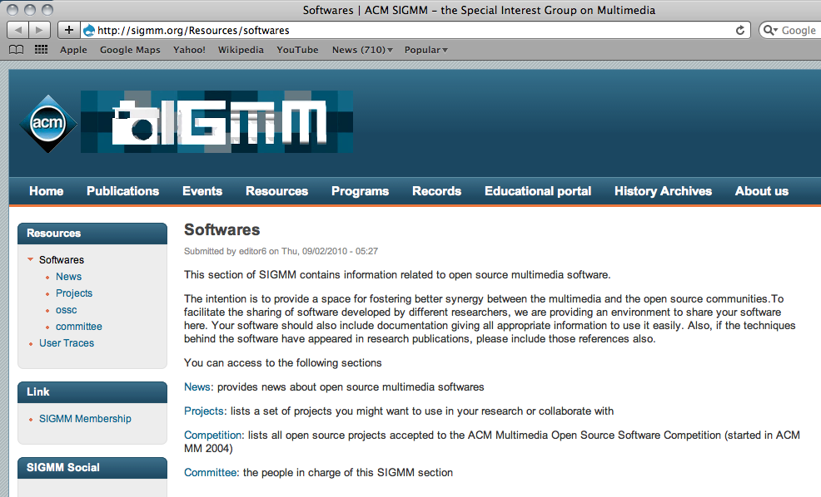
http://sigmm.org/Resources/softwares

Slide 34
Contents
Section dedicated to open source multimedia projects
OSSC
Dedicated to the ACM Multimedia’s OSSC
History preservation (links, digital library)
Projects (in progress)
Collection of over 50 multimedia open source projects
Aim: foster collaboration

Slide 35
Contents
Next steps
Projects: better visualization (tagging and descriptions)
Wiki-Style

Slide 36
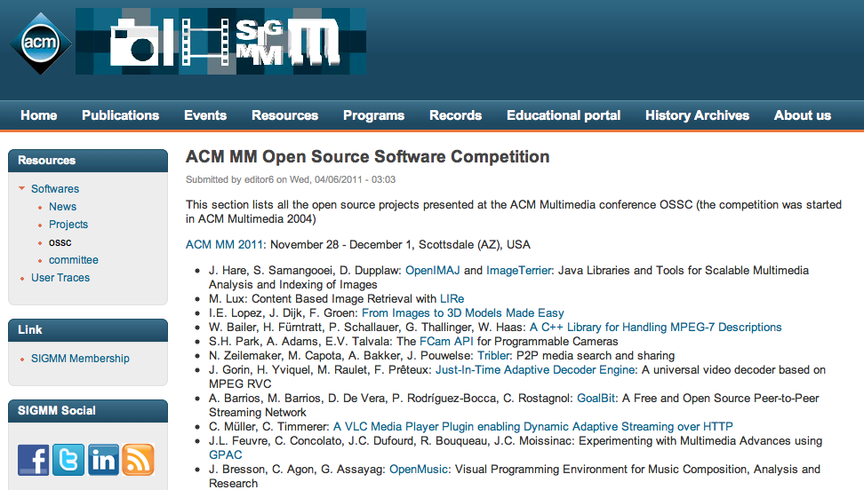
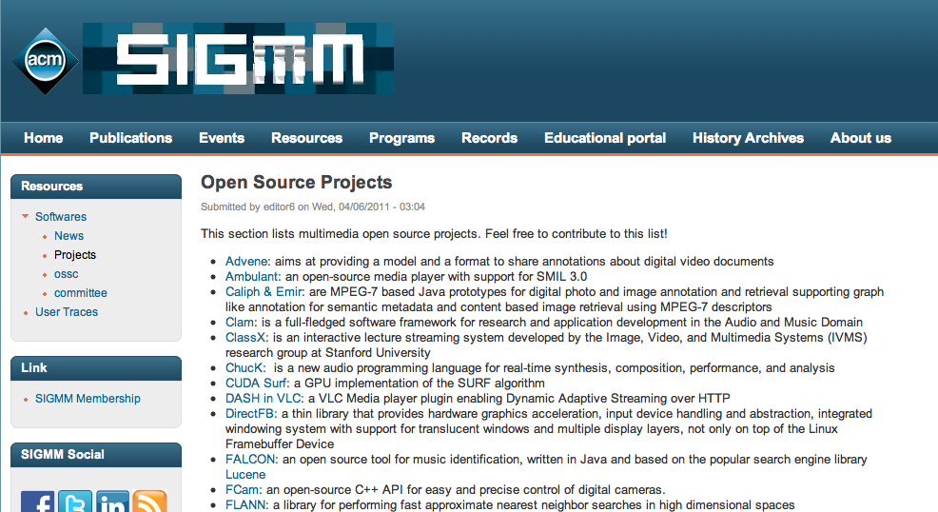
Contents

Slide 37
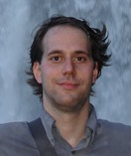
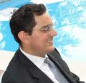
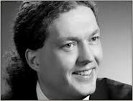
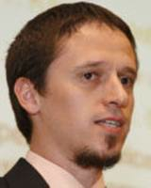
Team
Pablo Cesar, CWI, The Netherlands (editor)
Marco Bertini, Florence University, Italy
Ansgar Scherp, University of Koblenz-Landau, Germany
Christian Timmerer, Klagenfurt University, Germany
… interested? Please ask…

Slide 38
Social Media
Marcel Worring
Kasim Selcuk Candan

Slide 39
WHAT is HIVE^{beta}?
Hive is an open research network – a social platform for
fostering scientific interactions and
facilitating scientific exchanges.
Using Hive (hive.asu.edu), you can
seed and expand your research network,
discover and learn about colleagues,
share your ideas,
ask questions, give and receive comments, or
simply keep and/or view a record of your activities and interactions in MM’11.

Slide 40
Social Media @ sigmm.org
SIGMM.org
Should become the digital meeting place for Multimedia
We already started the LinkedIn group
but still many of you should be connected
The Hive team
is willing to connect their tool
Scientificareers.com
Contributed by Alberto del Bimbo and Shih-Fu Chang for jobs
But we can do much more
Any suggestions or ideas?
E-mail:
m.worring@uva.nl
candan@asu.edu

Slide 41
http://sigmm.org/records
ACM SIGMM’s quarterly newsletter
Carsten Griwotz
Editor-in-Chief of SIGMM records
ACM DL: http://dl.acm.org/citation.cfm?id=J1232
ISSN 1947-4598

Slide 42
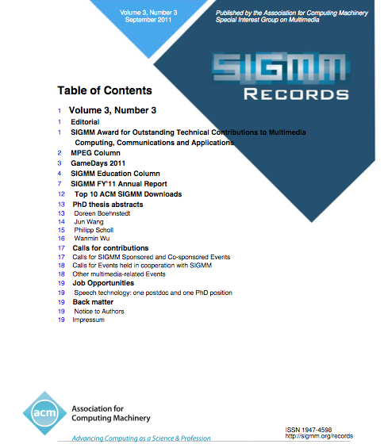
a year of http://sigmm.org/records

Slide 43
a year of http://sigmm.org/records
Available in PDF and HTML
from sigmm.org and PDF from the ACM DL
Records for posterity:
Events in the multimedia community
Expert interviews
SIGMM official business
PhD theses with multimedia topics
Publicity and ACM DL inclusion
for PhD theses (20)
Citable summaries
Easier to find than universities’ libraries
Official calls & announcements (12)
Other regular columns
Education column
MPEG column
Open source column
Reports from multimedia conferences and journals, with DOIs to all papers (14)

Slide 44
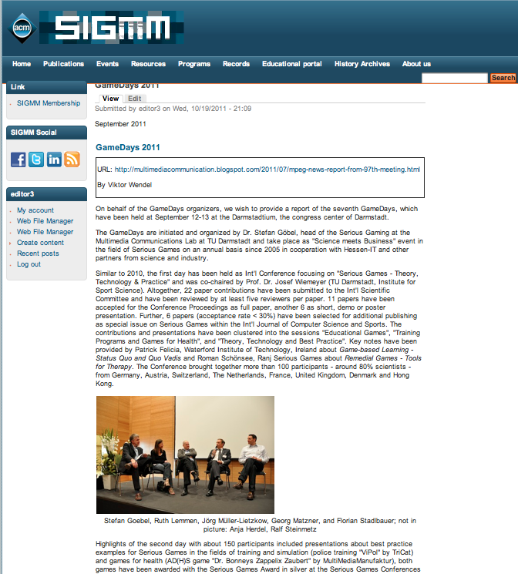
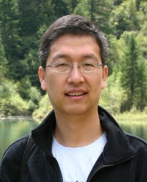
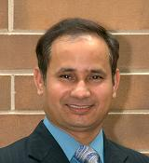
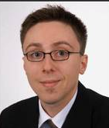
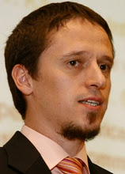
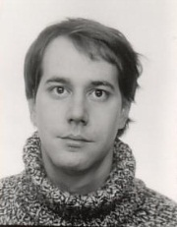
http://sigmm.org/records editors
2010
2011
2012
Carsten Griwodz
Systems and HCI thesis summaries,
Records publication
Lei Zhang
Contents and Application thesis summaries
Pradeep Atrey
Education column
Stephan Kopf
Calls for
Contributions
Games events and reports
Viktor Wendel
MPEG column
Christian Timmerer
Open source
column
Pablo Cesar
Your name here?

Slide 45
http://sigmm.org/records
Publish:
http://sigmm.org/records/contribute.html
mailto:enews-contributions@sigmm.org
Join the editor team:
report from your multimedia community
propose new columns
improve the Records’ look and feel

Slide 46
SIGMM Educational Initiatives Report
To increase awareness of educational activities around SIGMM community
Ooi Wei Tsang, Education Editor
To promote sharing of educational information and resources in the SIGMM community

Slide 47
1. Web Portal
Information about MM-related programs, courses, textbooks, A/V materials
New section: Software you can use for teaching MM-related courses
Next: new section on demos

Slide 48
Column in SIGMM Records
New column highlighting education-related activities around the community.
Featured four courses and one textbook so far.
Current column editor: Pradeep Atrey (University of Winnipeg)

Slide 49
Open Source Software
The OSSC competition this year includes call for educational software used to teach MM-related courses.
Out of 14 accepted entries, 5 have been used in teaching as assignments/projects

Slide 50
education@sigmm.org
www.sigmm.org/Education

Slide 51
SIGMM History Preservation
Goal:
Preserve the history of all conferences/workshops organized by ACM SIGMM
Mechanism:
Create archive for information about all past events
Archive contains:
Cached copy of event’s web site
Date/place and general chair(s)
Committee:
Mohamed Hefeeda, Cheng-Hsin Hsu, and Ahmed Hamza
New URL: http://www.sigmm.org/Preservation/history-archives
Issue: We no longer have sftp access at the new Web server
Myunghoon uploaded files for us, which incurred overhead

Slide 52
Currently Archived Conferences
ACM Multimedia: 1993—2011
Missing info for: 2003, 2000, 1994, 1993
MMSys: 2010—2011
ICMR: 2011
NOSSDAV: 1990—2011
Missing info for: 1993, 1992, 1991, 1990
MM & Security: 1998—2011
Missing info for: 2005, 2003
CIVR: 2002—2010 ← Merged with MIR into ICMR
Missing info for: 2004, 2008
MIR: 1999—2010 ← Merged with CIVR into ICMR
Thanks for helping us to locate the archive of 6 prior conferences
Please contact us if you know more about the currently missing ones (email: mhefeeda@cs.sfu.ca)

Slide 53
SIGMM Conferences
November 30 2011
Mohan S Kankanhalli
mohan@comp.nus.edu.sg URL: http://www.comp.nus.edu.sg/~mohan/

Slide 54
Work Done Last Year
Implementation of ACM Multimedia Review Report
Worked with ACM Multimedia 2011 for the changes
Formation of the ACM Multimedia Conference Steering Committee
Major Operational Change Introduced: Chairs to submit conference report within two months of the conference
(Panch/Selcuk/Prabha: please note!)

Slide 55
ACM Multimedia Conference Steering Committee Charter
“The roles of AMCSC are to oversee the proper selection of key appointment holders and smooth execution for each conference, as well as to ensure the adherence of best practices as prescribed in the conference guidelines.”
Notes:
55

Slide 56
ACM Multimedia Conf. Steering Committee
Mohan Kankanhalli, Ex Officio (one term only: Jul 2011 - Jun 2013)
Michael Lew (one term only: Jul 2011 - Jun 2013)
Alberto del Bimbo (Jul 2011 - Jun 2013 with possibility of renewal)
Yong Rui (Jul 2011 - Jun 2013 with possibility of renewal)
Abdulmotaleb El Saddik (Jul 2011 - Jun 2013 with possibility of renewal)
Sethuraman Panchanathan (Jul 2011 - Jun 2013 with possibility of renewal)

Slide 57
Work to be Done Next Year
Look at all SIGMM sponsored and supported conferences to see whether things can be done in a better way….
Look at Budgeting Issues for Affordability and Quality…
Streamline Steering Committee Work

Slide 58
WANTED!!!
Bids for
ACM Multimedia 2015
in Asia

Slide 59
Thank you!
Over to Gerald (San Francisco) and Kien (Orlando) now to present bids for ACM Multimedia 2014…..

